Slide 1
Functions
Rosen section 1.8

Slide 2
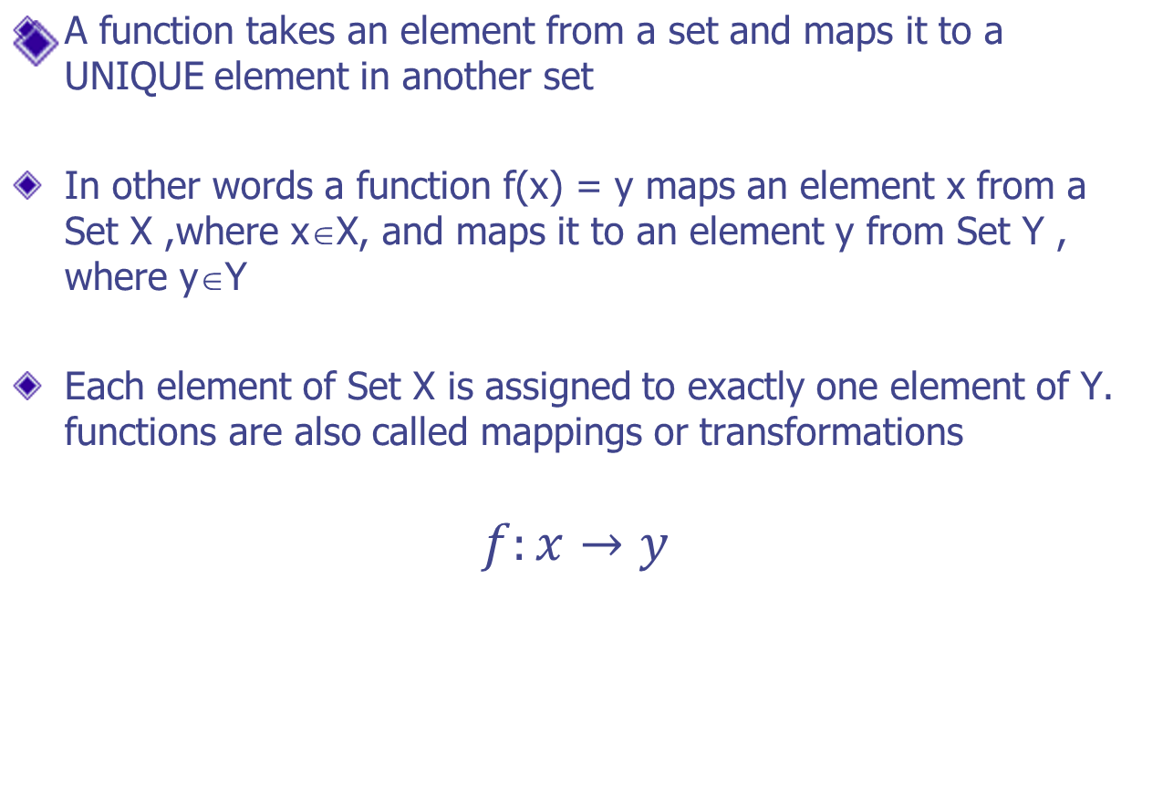
Definition of a function
Function mapping x to y
Domain
codomain
mapping

Slide 3
Function terminology
Suppose that to each element of a set A there is assigned a unique element of a set B; the collection of such assignments is called a function from A into B. The set A is called the domain of the function and The set B is called the codomain. Let f denote a function from A into B; f : A B
A
f
B
Co-domain
Domain
f(1) = A
1
A
2
f(2)
f(3)
B
3
C
f(4)
4
D
5
f(5)
E
Pre-image of 4
Where 4 ∈ R
Image of 4

Slide 4
continued
If a ∈ A, then we let f(a) (read as "f of a") denote the unique element of B which f assigns to a;
It is called the image of a under f, or the value of f at a.
The set of all image values is called the range or image of f
Therefore, based on the previous example given:
  f(1) = A
  f(4) = D
Image : A is the image of 1 under f
Pre-Image: 1 is the preimage of A under f
Image : D is the image of 4 under f
Pre-Image: {4, 5} is the preimage of D under f
Range : (set of all mapped codomain values )
: {A, B, C, D}

Slide 5
More functions
A pre-image
of 1
The image
of A
Domain
Co-domain
Alice
Bob
Chris
Dave
Emma
A
B
C
D
F
“a”
“bb“
“cccc”
“dd”
“e”
1
2
3
4
5
A class grade function
A string length function

Slide 6
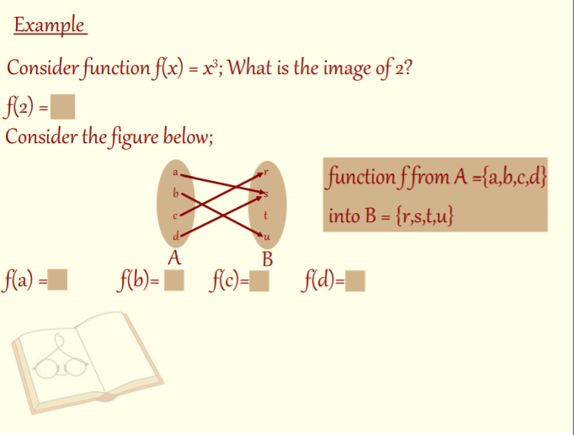


Slide 7
Even more functions
Range
a
e
i
o
u
1
2
3
4
5
“a”
“bb“
“cccc”
“dd”
“e”
1
2
3
4
5
Some function…
Not a valid function!
Also not a valid function!

Slide 8
Function arithmetic
Let f₁(x) = 2x
Let f₂(x) = x²
f₁+f₂ = (f₁+f₂)(x) = f₁(x)+f₂(x) = 2x+x²
f₁*f₂ = (f₁*f₂)(x) = f₁(x)*f₂(x) = 2x*x² = 2x³

Slide 9
One-to-one functions
A function is one-to-one if each element in the co-domain has a unique pre-image
a
e
i
o
1
2
3
4
5
a
e
i
o
1
2
3
4
5
A one-to-one function
A function that is
not one-to-one

Slide 10
More on one-to-one
The term Injective is synonymous with one-to-one
  “A function is injective”
A function is an injection if it is one-to-one
Note that there can
be un-used elements
in the co-domain
a
e
i
o
1
2
3
4
5
A one-to-one function

Slide 11
Onto functions
A function is onto if each element in the co-domain is an image of some pre-image
a
e
i
o
u
1
2
3
4
a
e
i
o
1
2
3
4
5
An onto function
A function that is not onto

Slide 12
More on onto
The term Surjective is synonymous with onto
  “A function is surjective”
A function is an surjection if it is onto
Note that there can
be multiply used
elements in the
co-domain
a
e
i
o
u
1
2
3
4
An onto function

Slide 13
Bijections
Consider a function that is
both one-to-one and onto:
Such a function is a one-to-one correspondence, or a bijection
a
b
c
d
1
2
3
4

Slide 14
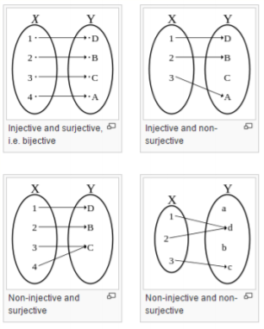
Example

Slide 15
Onto vs. one-to-one
Are the following functions onto (surjective), one-to-one (injective), both (bijective), or neither?
a
b
c
1
2
3
4
a
b
c
d
1
2
3
4
a
b
c
1
2
3
4
a
b
c
d
1
2
3
a
b
c
d
1
2
3
4

Slide 16
Identity functions
A function such that the image and the pre-image are ALWAYS equal
f(x) = 1*x
f(x) = x + 0
The domain and the co-domain must be the same set

Slide 17
Inverse functions
If f:A → B is a bijection then the inverse of f, denoted by f^{‐1} is defined by / as the function f ^{‐1} : B → A such that f ^{‐1} (b) = a iff f(a) = b.
If f is not a bijection, then the inverse function does not exist.
Let f(x) = 2*x
A
f
B
f⁻¹
f (a)
a = f ^{‐1} (b)
b = f (a)
f(4.3)
4.3
8.6
f⁻¹(8.6)
f ^{‐1} (b)
Then f⁻¹(x) = f(x)/2
An inverse function can ONLY be done defined on a bijection

Slide 18
More on inverse functions
Can we define the inverse of the following functions?
a
b
c
1
2
3
4
a
b
c
d
1
2
3
What is f⁻¹(2)?
Not onto!
What is f⁻¹(2)?
Not 1-to-1!

Slide 19
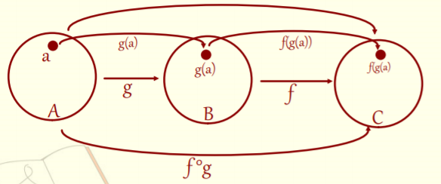
Compositions of functions
Definition : Let f: B → C and g: A → B. The composition function f ○ g is defined by f ○ g: A → C with f ○ g(a)=f(g(a))
Let (f ○ g)(x) = f(g(x))
Let f(x) = 2x+3 Let g(x) = 3x+2
g(1) = 5, f(5) = 13
Thus, (f ○ g)(1) = f(g(1)) = 13

Slide 20
Compositions of functions
Let f(x) = 2x+3 Let g(x) = 3x+2
f ○ g
R
R
R
g
f
g(1)
f(5)
f(g(1))=13
1
g(1)=5
(f ○ g)(1)
f(g(x)) = 2(3x+2)+3 = 6x+7

Slide 21
Compositions of functions
Does f(g(x)) = g(f(x))?
Let f(x) = 2x+3 Let g(x) = 3x+2
f(g(x)) = 2(3x+2)+3 = 6x+7
g(f(x)) = 3(2x+3)+2 = 6x+11
Function composition is not commutative!
Not equal!

Slide 22
Graphs of functions
Every function f: A → B gives rise to a relation from A to B called the graph of f and defines by
Graph of f = {(a,b):a∈A, b = f(a)}
Two functions f: A → B and g: A → B are equal, written f = g, if f(a)=g(a) for every a ∈ A.
This goes on to imply that they have the same graph

Slide 23
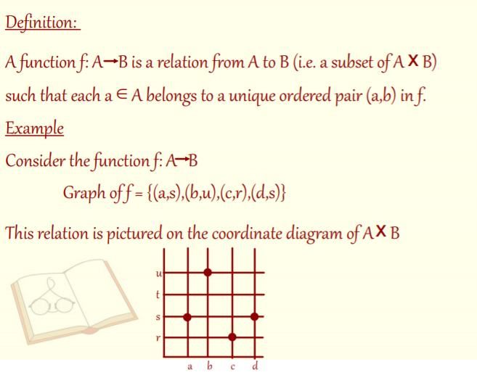
Graphs of functions

Slide 24
Graphs of functions
f(x)=3
x=1
Let f(x)=2x+1
Plot (x, f(x))
This is a plot
of f(x)
f(x)=5
x=2

Slide 25
Useful functions
Floor: ⎣x⎦ means take the greatest integer less than or equal to the number
Ceiling: ⎡x⎤ means take the lowest integer
greater than or equal to the number
round(x) = floor(x+0.5)

Slide 26
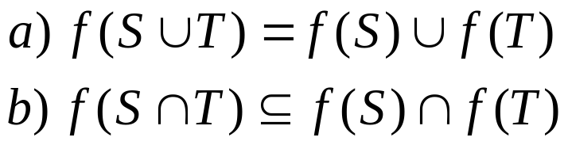
Proving function problems
Rosen, question 32, §1.8
Let f be a function from A to B, and let S and T be subsets of A. Show that

Slide 27
Proving function problems
Rosen, question 32 (a): f(SUT) = f(S) U f(T)
Will show that each side is a subset of the other
Two cases!
Show that f(SUT) ⊆ f(S) U f(T)
  Let b ∈ f(SUT). Thus, b=f(a) for some a∈S U T
  Either a∈S, in which case b∈f(S)
  Or a∈T, in which case b∈f(T)
  Thus, b∈f(S) U f(T)
Show that f(S) U f(T) ⊆ f(S U T)
  Let b ∈ f(S) U f(T)
  Either b ∈ f(S) or b ∈ f(T) (or both!)
  Thus, b = f(a) for some a ∈ S or some a ∈ T
  In either case, b = f(a) for some a ∈ S U T

Slide 28
Proving function problems
Rosen, question 32 (b): f(S∩T) ⊆ f(S) ∩ f(T)
Let b ∈ f(S∩T). Then b = f(a) for some a ∈ S∩T
This implies that a ∈ S and a ∈ T
Thus, b ∈ f(S) and b ∈ f(T)
Therefore, b ∈ f(S) ∩ f(T)

Slide 29
Proving function problems
Rosen, question 62, §1.8
Let f be an invertible function from Y to Z
Let g be an invertible function from X to Y
Show that the inverse of f○g is:
  (f○g)⁻¹ = g⁻¹ ○ f⁻¹

Slide 30
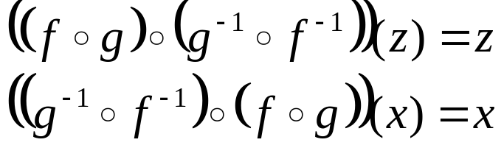
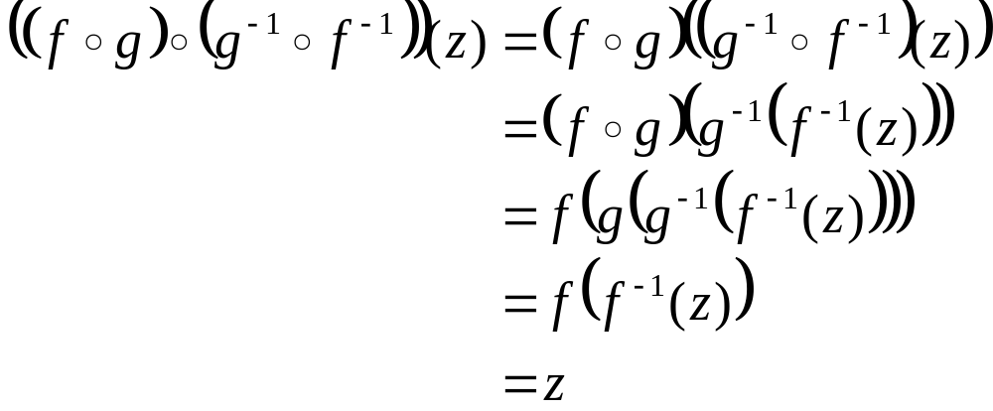
Proving function problems
Rosen, question 62, §1.8
Thus, we want to show,
for all z∈Z and x∈X
The second equality is similar

Slide 31
FIN

